Slide 1
Setting up React Native Development Environment
Chapter 12 – Setting up React Native Development Environment

Slide 2
Setting Up React Native Development Environment
React Native Development Environment
Setting up a React Native development environment involves configuring tools that allow you to build and run mobile applications on Android and iOS
React Native provides a framework for creating mobile apps using TypeScript and React, enabling developers to build cross-platform applications efficiently
Here are the steps to set up the React Native environment:
Install Java 17 (Oracle, Amazon Corretto, or Temurin)
Set the JAVA_HOME environment variable
Verify Java Installation
Install Android Studio (it will auto-detect Java if set properly)
Create AVD (Android Virtual Device)
Add Android SDK tools to PATH
Configure VS Code for Launching Android Emulators
Verify Emulator Setup with VS Code
Install Node.js, React Native CLI
Install yarn
Start developing

Slide 3
Setting Up React Native Development Environment
1. Install Java 17
Java 17 is recommended for React Native development, specifically for Android app development, because it is the version that aligns with the latest Android development tools and libraries
Android Studio and React Native CLI both require Java (especially for building APKs).
Java 17 is the proper choice for React Native development because:
Compatibility with Android SDK and Gradle
Android development, particularly using Android Studio, depends on Java. Gradle, the build system used by Android Studio, requires a specific version of Java to build Android apps. Java 17 is the latest version supported by Android Gradle Plugin and the Android SDK, ensuring compatibility with the newest tools and features.
Older versions of Java (e.g., Java 8 or Java 11) might work, but Java 17 provides better support, performance, and security.

Slide 4
Setting Up React Native Development Environment
Install Java 17
New Features and Performance Improvements
Java 17 includes important language features and performance improvements that enhance the stability, speed, and efficiency of Android apps, making the development process smoother and more reliable.
Official Support
As of now, Android Studio and the Android Gradle Plugin officially support Java 17. Using the latest version ensures you have access to the most recent bug fixes, security patches, and features offered by both the Android ecosystem and Java itself.
Security and Long-Term Support
Java 17 is a Long-Term Support (LTS) release, which means it will receive updates and security patches for several years. This is crucial for ensuring the security and stability of your development environment and applications.

Slide 5
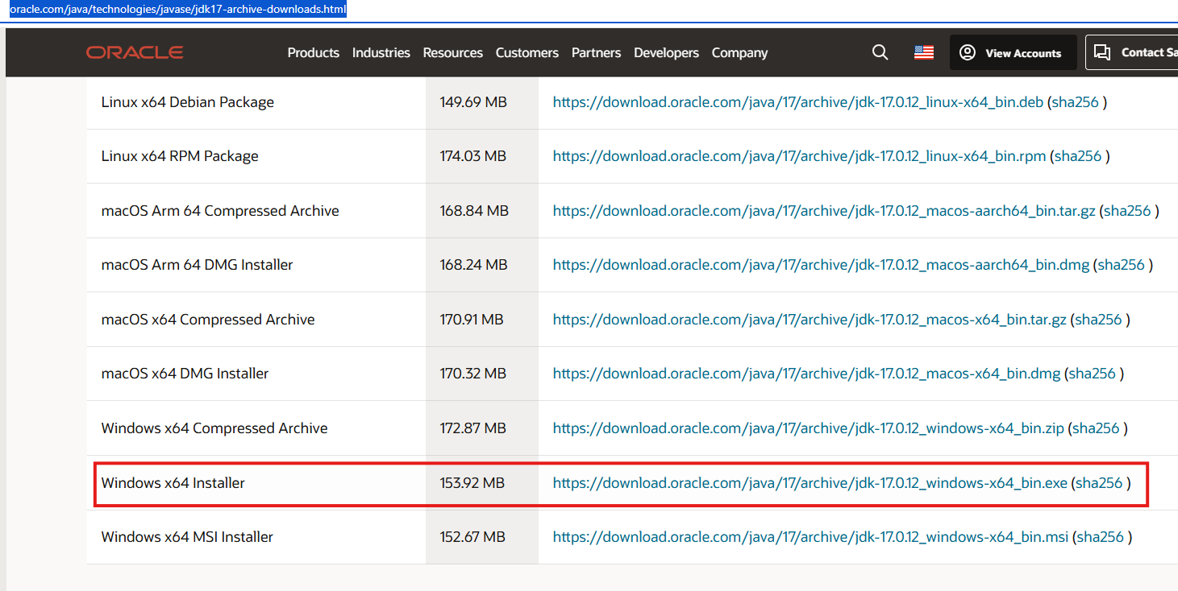
Setting Up React Native Development Environment
Install Java 17
Download and install Java 17 at the below link:
https://www.oracle.com/java/technologies/javase/jdk17-archive-downloads.html

Slide 6
Setting Up React Native Development Environment
2. Set the JAVA_HOME Environment Variable
Setting the JAVA_HOME environment variable is crucial because it tells your operating system where to find the Java Development Kit (JDK) installation on your machine
This is essential for various development tools and programs, including Android Studio, Gradle, and React Native, to properly locate and utilize the Java tools needed for building and running Android apps
Setting JAVA_HOME ensures your development environment is properly configured and that your system can efficiently locate and use the correct version of Java for your development needs

Slide 7
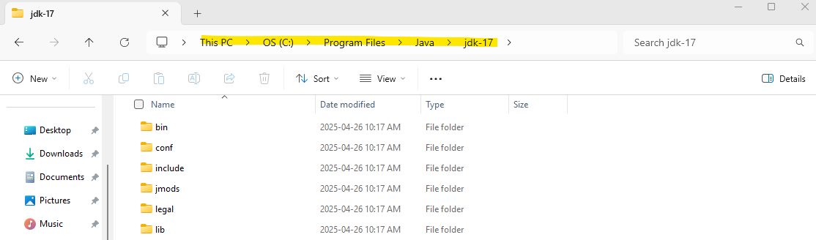
Setting Up React Native Development Environment
Set the JAVA_HOME Environment Variable
To set the JAVA_HOME variable, first find the path where Java is installed and copy the path
It’s usually installed in the below path:
C:\Program Files\Java\jdk-17

Slide 8
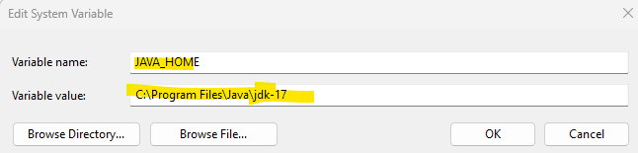
Setting Up React Native Development Environment
Set the JAVA_HOME Environment Variable
To set the JAVA_HOME variable on Windows:
Search for "Environment Variables" in Start menu
Click Edit the system environment variables
In the System Properties window, click Environment Variables
Under System variables, click New
Set:
Variable name: JAVA_HOME
Variable value: Path to your Java JDK folder (e.g., C:\Program Files\Java\jdk-17)

Slide 9
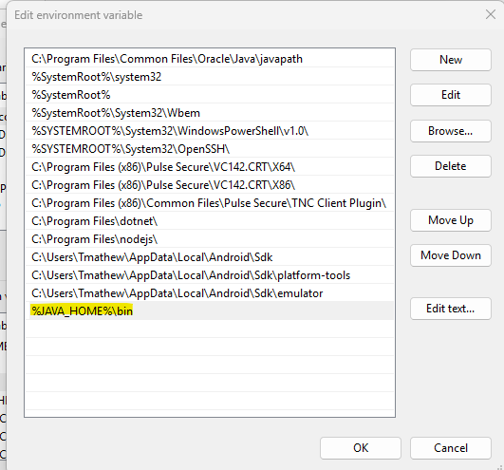
Setting Up React Native Development Environment
Add ‘%JAVA_HOME%\bin’ to the Path
By adding %JAVA_HOME%\bin to your Path, you enable the ability to run Java tools (such as java, javac, javadoc, etc.) from any directory in your terminal or command prompt
Add %JAVA_HOME%\bin to your Path variable under System Variables

Slide 10

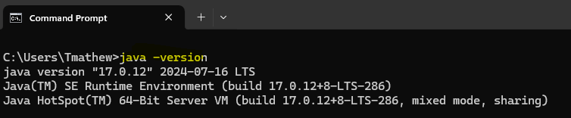
Setting Up React Native Development Environment
3. Verify Java Installation
Restart your computer after all the above are set
Run the command echo %JAVA_HOME% on command prompt (cmd), you should see your JDK path displayed
Check the Java version installed by running the command java -version

Slide 11
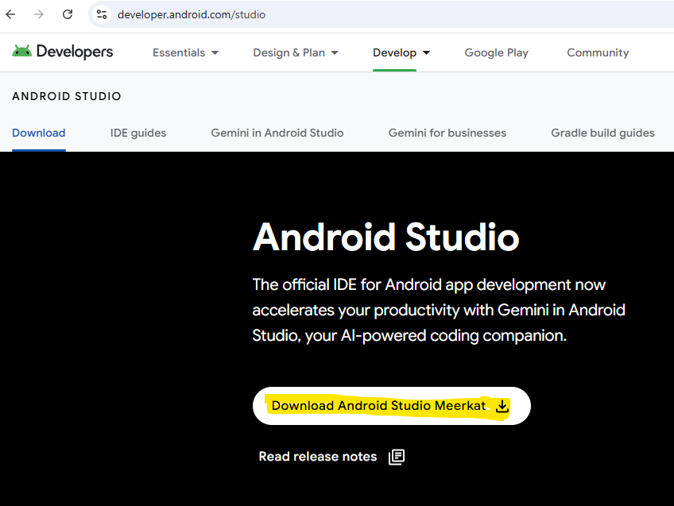
Setting Up React Native Development Environment
4. Install Android Studio
Android Studio is essential for React Native development because it provides the Android SDK, necessary for building and running Android apps
It also includes an emulator for testing, Gradle for automating builds, and tools for managing native Android code
Additionally, Android Studio simplifies setting up and managing Android Virtual Devices (AVDs) and ensures you have the proper environment for debugging and developing Android-specific features in your React Native app
Download and install Android Studio at the link https://developer.android.com/studio

Slide 12
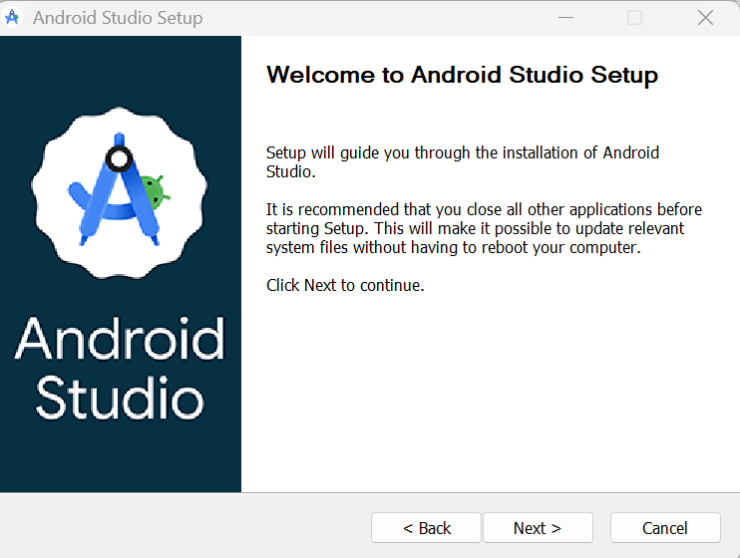
Setting Up React Native Development Environment
Install Android Studio
Click ‘Next’

Slide 13
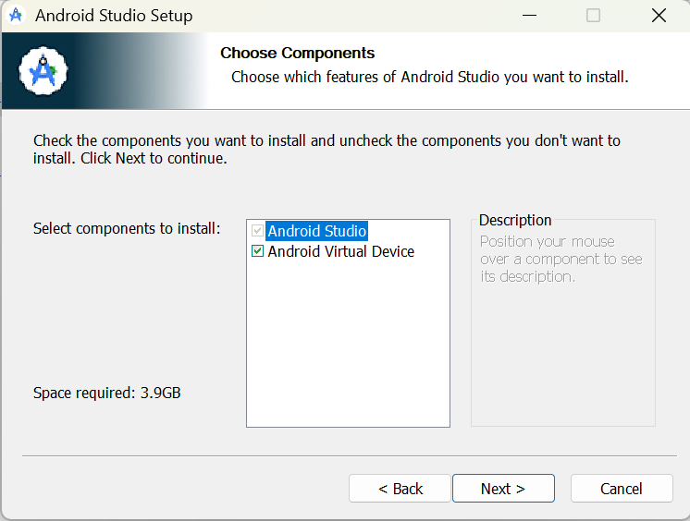
Setting Up React Native Development Environment
Install Android Studio
Make sure that you have selected ‘Android Virtual Device’
Click ‘Next’

Slide 14
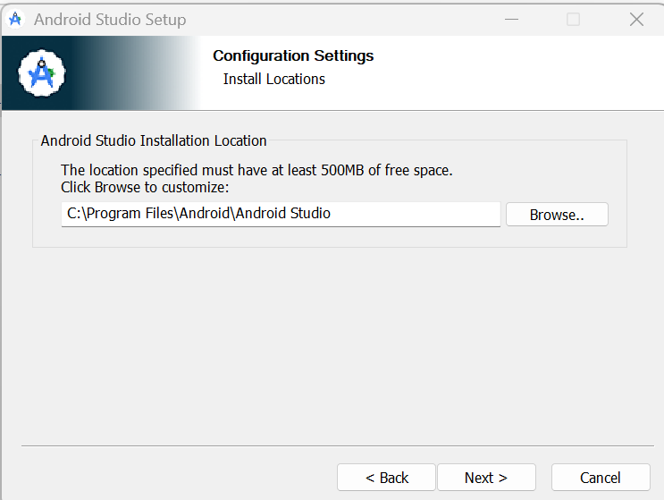
Setting Up React Native Development Environment
Install Android Studio
Keep the default location for installing Android Studio
Click ‘Next’

Slide 15
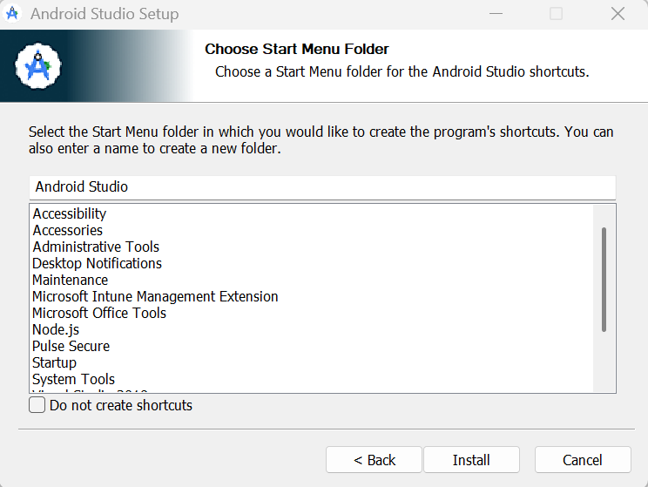
Setting Up React Native Development Environment
Install Android Studio
Click ‘Next’

Slide 16
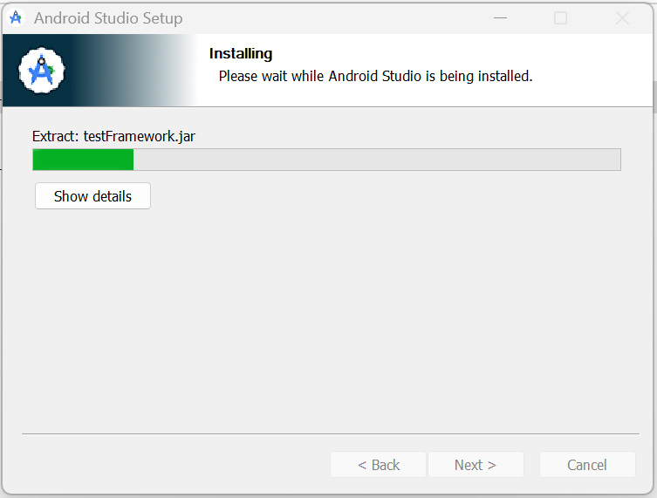
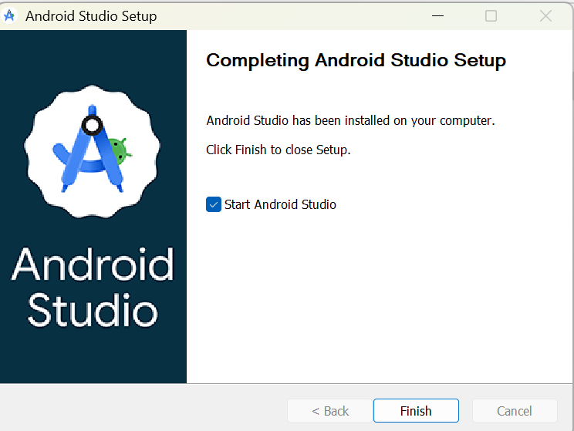
Setting Up React Native Development Environment
Install Android Studio
Click ‘Finish’

Slide 17
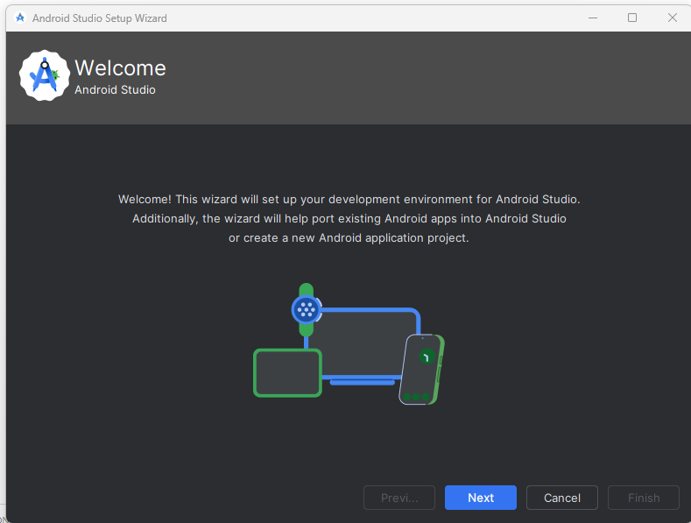
Setting Up React Native Development Environment
Install Android Studio
Launch Android Studio
Click ‘Next’

Slide 18
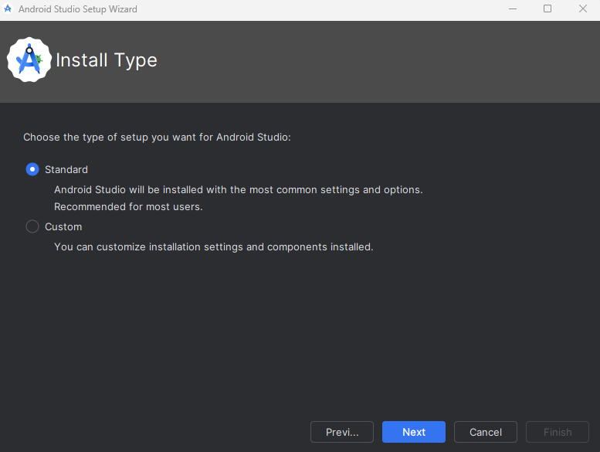
Setting Up React Native Development Environment
Install Android Studio
Keep the standard type of set up
Click ‘Next’

Slide 19
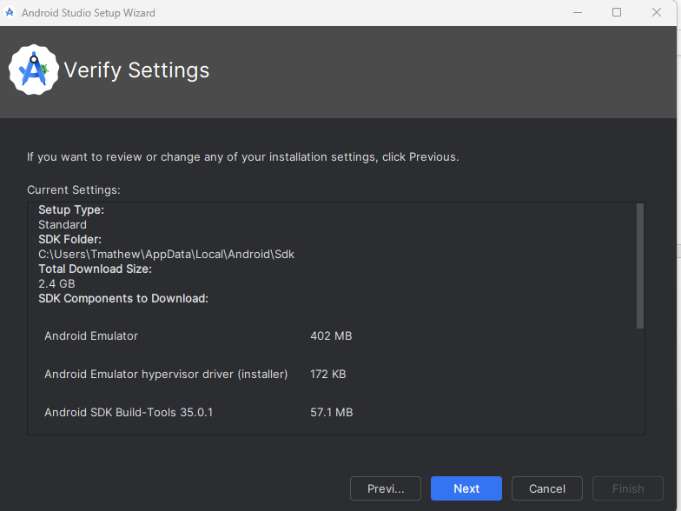
Setting Up React Native Development Environment
Install Android Studio
Click ‘Next’

Slide 20
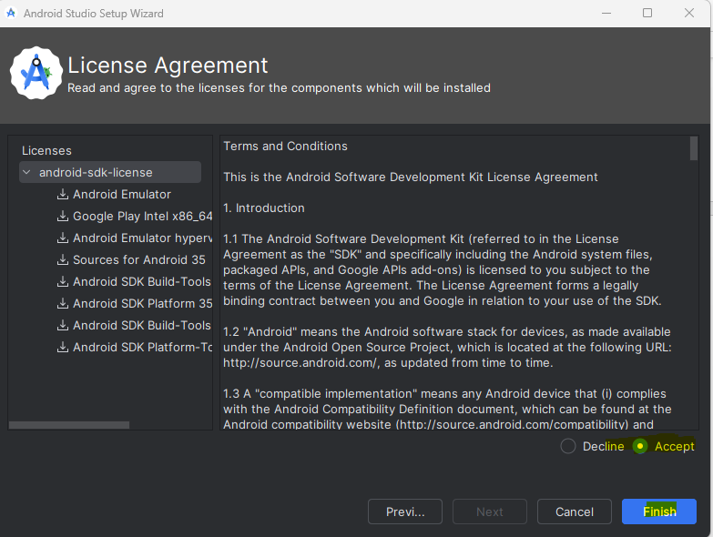
Setting Up React Native Development Environment
Install Android Studio
Accept the license agreement
Click ‘Finish’

Slide 21
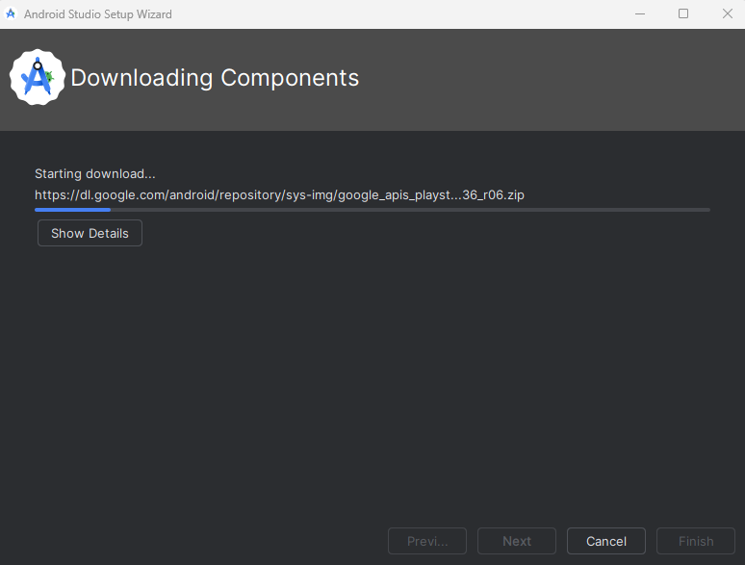
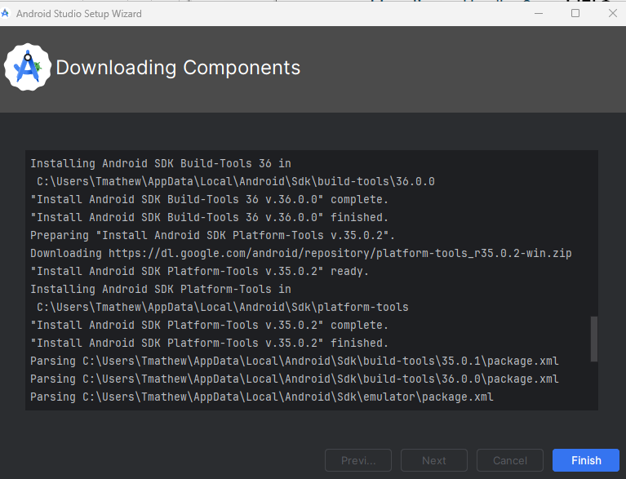
Setting Up React Native Development Environment
Install Android Studio
Click ‘Finish’ once downloading the components is completed
Now you will be taken to ‘Welcome Screen’ of Android Studio

Slide 22
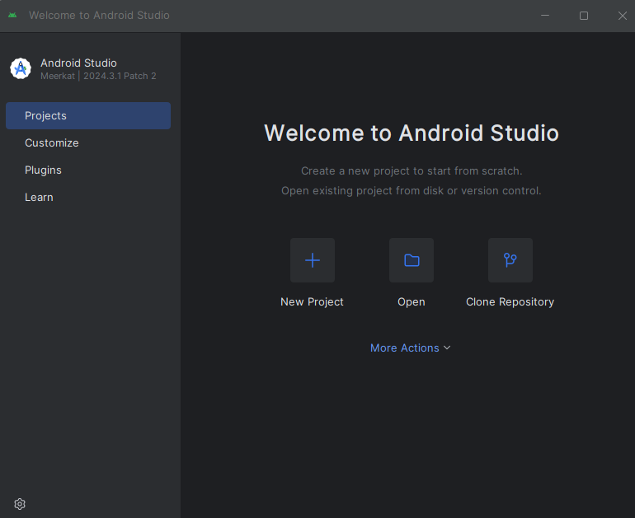
Setting Up React Native Development Environment
Install Android Studio
Now the Android Studio Installation is completed

Slide 23
Setting Up React Native Development Environment
5. Create AVD (Android Virtual Device)
We create an AVD (Android Virtual Device) for React Native development to simulate a real Android device on our computer
This allows us to build, run, and test our React Native apps without needing a physical Android phone
It helps in quickly checking the app’s layout, functionality, and performance during development

Slide 24
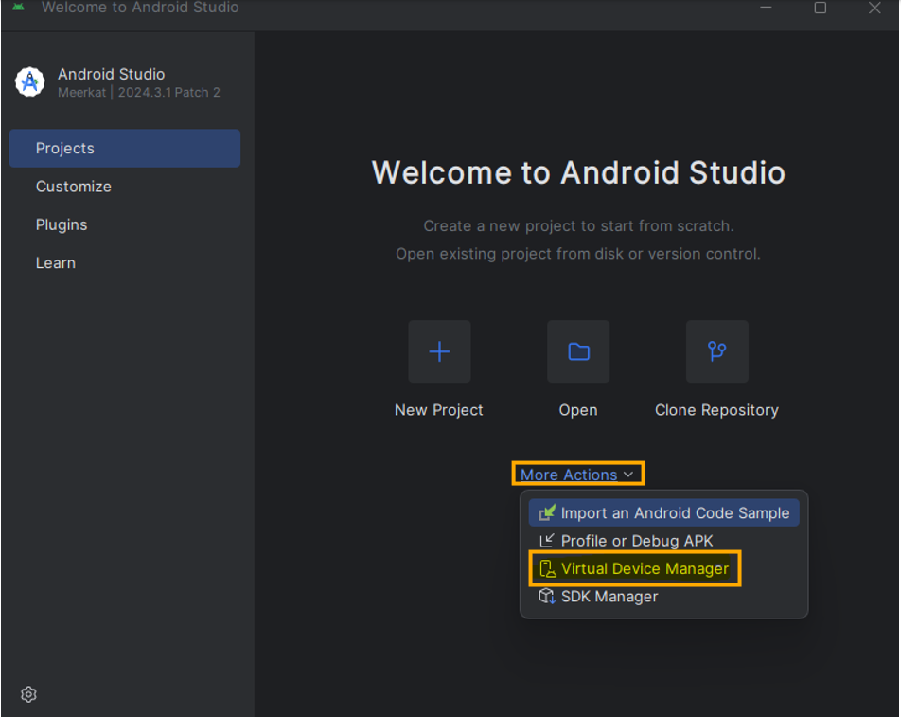
Setting Up React Native Development Environment
Create AVD (Android Virtual Device)
To create a virtual device:
Choose ‘Virtual Device Manager’ from ‘More Options’
OR
Select Tools -> Device Manager (If you are inside an Android project)

Slide 25
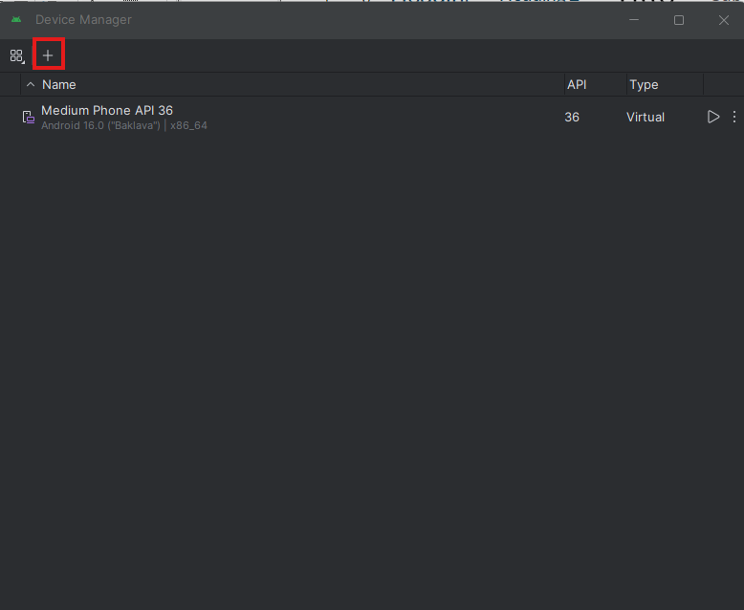
Setting Up React Native Development Environment
Create AVD (Android Virtual Device)
Click ‘Create Virtual Device’ icon (+)

Slide 26
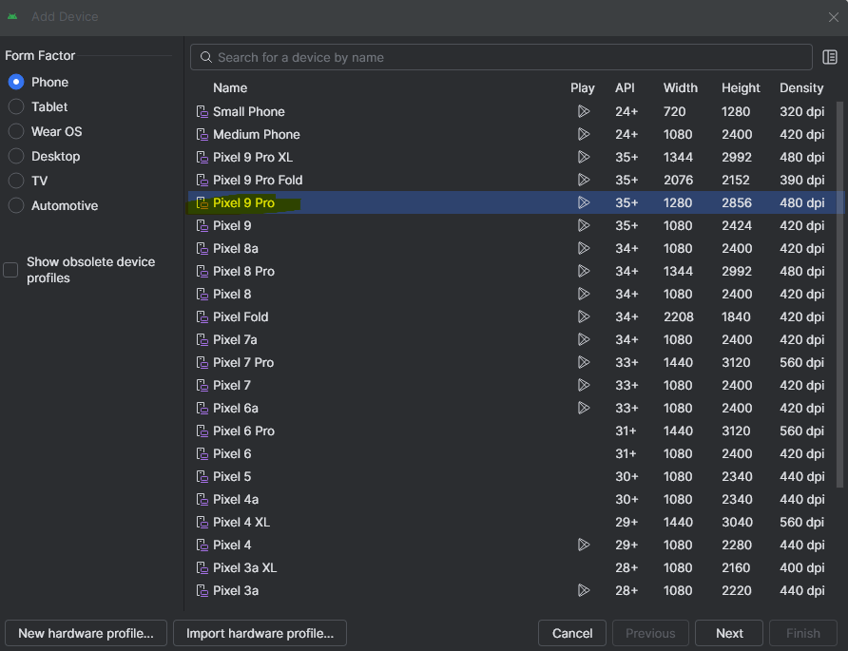
Setting Up React Native Development Environment
Create AVD (Android Virtual Device)
Select a device (say Pixel 9 Pro) and click ‘Next’

Slide 27
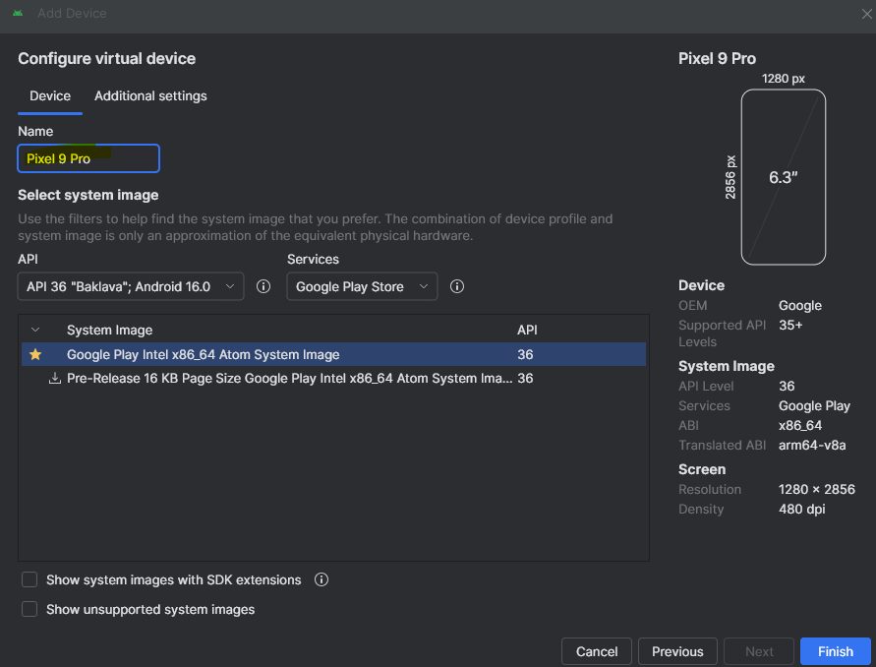
Setting Up React Native Development Environment
Create AVD (Android Virtual Device)
Give a name for the emulator, say ‘Pixel 9 Pro’
Select a system image (Android OS version), keep default selected
Click ‘Finish’

Slide 28
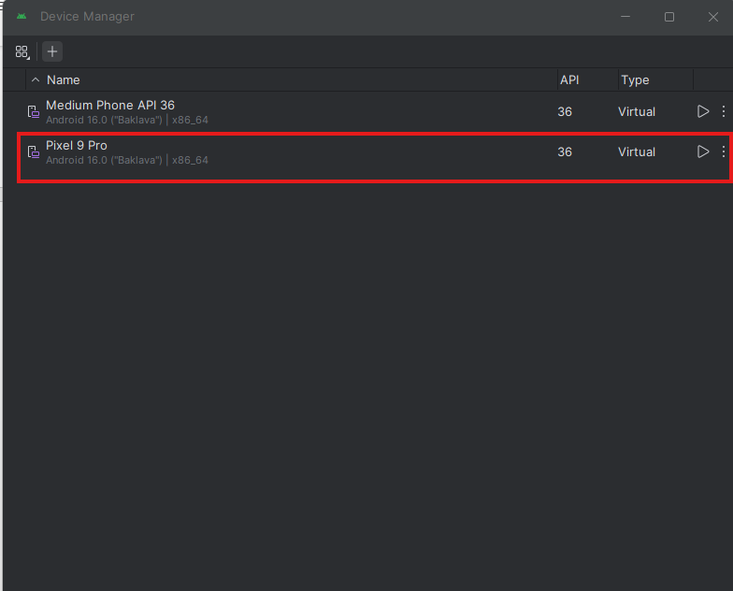
Setting Up React Native Development Environment
Create AVD (Android Virtual Device)
A new emulator (AVD) is created as below:
To verify the emulator is working well, click the ‘Start’ button at the right

Slide 29
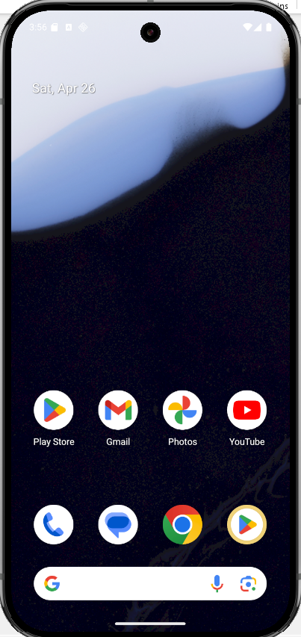
Setting Up React Native Development Environment
Create AVD (Android Virtual Device)
The Android emulator is launched as below:

Slide 30
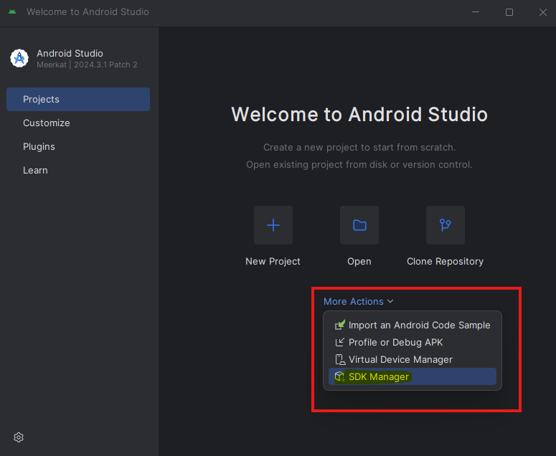
Setting Up React Native Development Environment
6. Add Android SDK tools to PATH
A. Find Android SDK location
Find your Android SDK Location
Tap the ‘More Options’ drop down from the Android Welcome Screen and select ‘SDK Manager’
OR
Choose Tools -> SDK Manager (if you are inside an Android project)

Slide 31
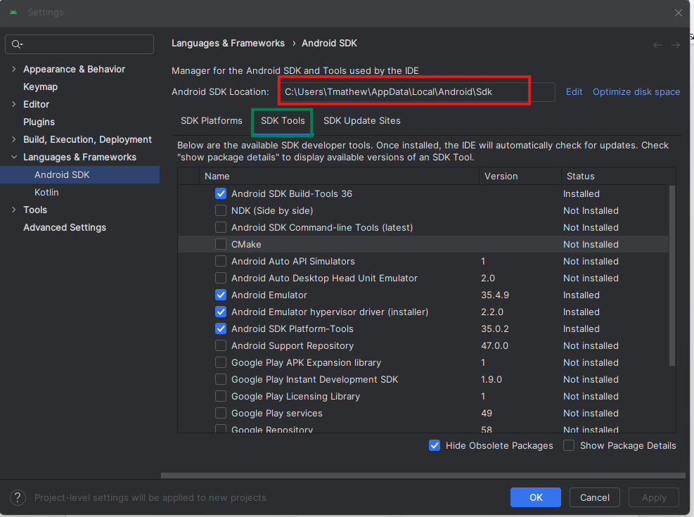
Setting Up React Native Development Environment
Add Android SDK tools to PATH
Copy the Android SDK location which is something like C:\Users\Tmathew\AppData\Local\Android\Sdk

Slide 32
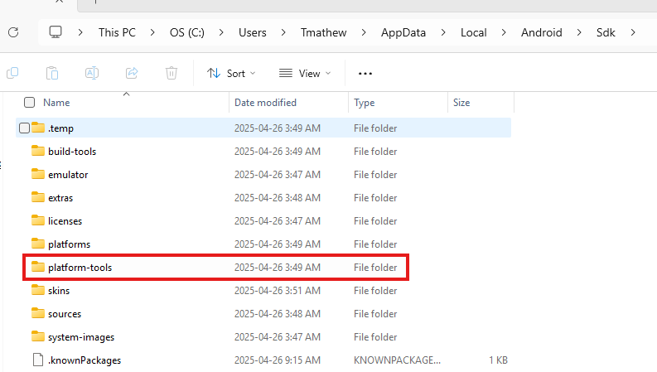
Setting Up React Native Development Environment
Add Android SDK tools to PATH
B. Find the “platform-tools" folder location
Open the above SDK path folder in Windows Explorer
(Note: The AppData folder may not be visible in Windows Explorer. Unhide the items in this folder)
You should see a platform-tools folder in the SDK folder.
Copy the path to the platform-tools folder
C:\Users\Tmathew\AppData\Local\Android\Sdk\platform-tools

Slide 33
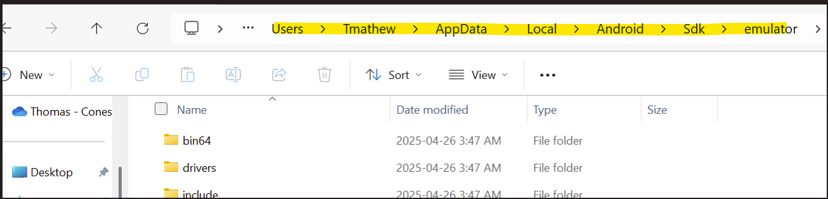
Setting Up React Native Development Environment
Add Android SDK tools to PATH
C. Find the emulator path location
Open the above SDK path folder in Windows Explorer
You should see an ‘emulator’ folder in the SDK folder.
Copy the path to the emulator folder
C:\Users\Tmathew\AppData\Local\Android\Sdk\emulator

Slide 34
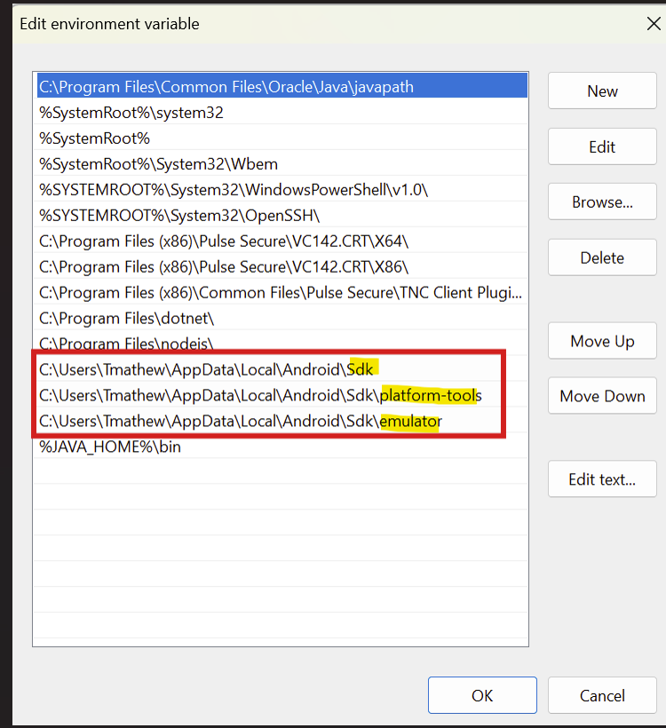
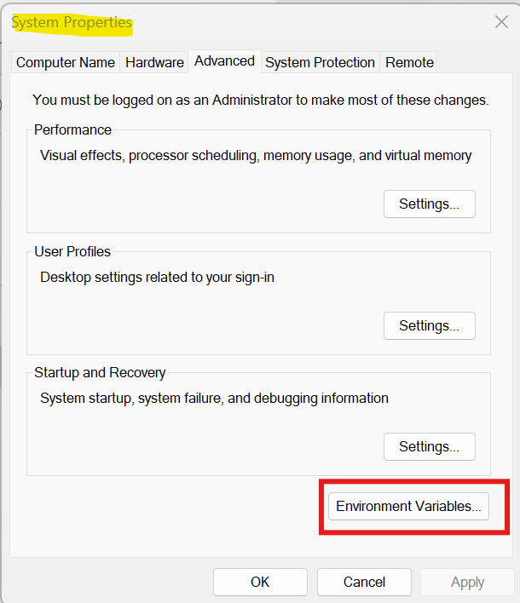
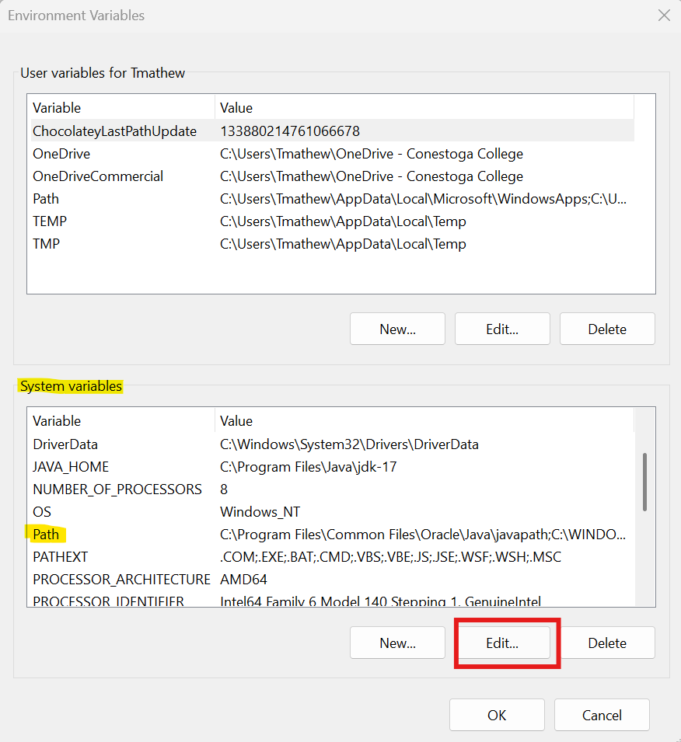
Setting Up React Native Development Environment
Add Android SDK tools to PATH
D. Add the SDK, plat-tools, and emulator paths in the System PATH in Windows
Press Windows Key, search for "Environment Variables".
Choose ‘Environment Variables’ from the ‘System Properties’ dialog box that opens
In System variables, select ‘Path’ and click ‘Edit’
Click ‘New’ in the ‘Edit environment variable’ dialog box that opens
Add the SDK path
Similarly add the platform-tools, and emulator path also

Slide 35
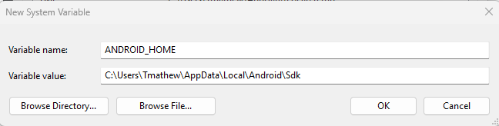
Setting Up React Native Development Environment
Add Android SDK tools to PATH
E. Set ANDROID_HOME variable
We set the ANDROID_HOME environment variable to tell development tools like React Native CLI and Gradle where the Android SDK is installed
Create a new system variable ‘ANDROID_HOME’ and set it with the path to C:\Users\Tmathew\AppData\Local\Android\Sdk

Slide 36
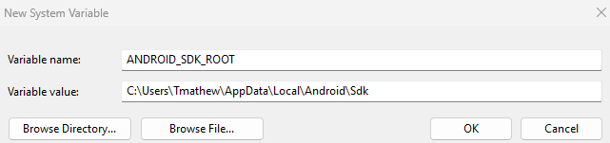
Setting Up React Native Development Environment
Add Android SDK tools to PATH
F. Set ANDROID_SDK_ROOT variable
We set the ANDROID_SDK_ROOT environment variable to specify the location of the Android SDK so that tools like the Android Emulator, build tools, and React Native can correctly find and use it
Create a new system variable ‘ANDROID_SDK_ROOT’ and set it with the path to C:\Users\Tmathew\AppData\Local\Android\Sdk

Slide 37
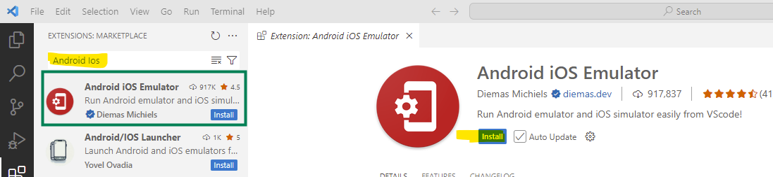
Setting Up React Native Development Environment
7. Configure VS Code for Launching Android Emulator
We can start Android emulators directly from the VS Code toolbar for quick testing
To configure VS Code for launching an Android Emulator:
Install the "Android iOS Emulator" extension in VS Code
Set Emulator path inside VS Code settings manually
1. Install the "Android iOS Emulator" extension in VS Code
​The Android iOS Emulator is a Visual Studio Code extension that allows you to launch Android and iOS emulators directly from the VS Code interface
It simplifies the process of testing and debugging mobile applications by integrating emulator controls within your development environment

Slide 38
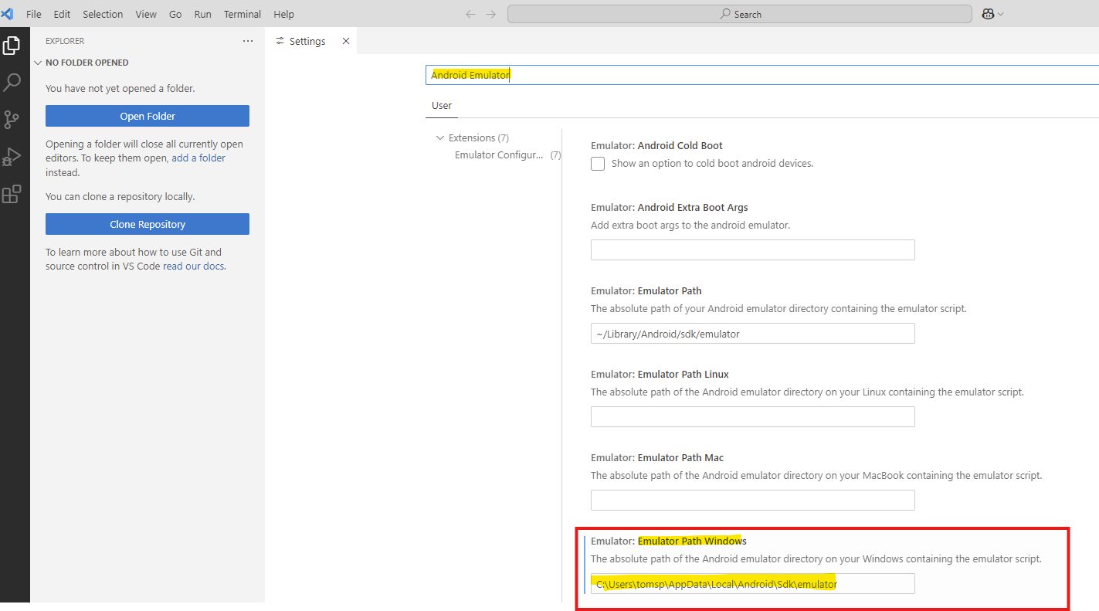
Setting Up React Native Development Environment
Configure VS Code for Launching Android Emulator
2. Set Emulator path inside VS Code settings manually
​Open VS Code
Go to Settings (Ctrl + ,) (File -> Preferences -> Settings)
Search for "Android Emulator"
Find setting called:
Emulator Path to Windows
Enter the full path to your emulator.exe

Slide 39


Setting Up React Native Development Environment
8. Verify Emulator Setup with VS Code
List all connected Android devices
adb devices is a command used with Android Debug Bridge (ADB) to list all connected Android devices and emulators
Open a new terminal in VS code and run the following command (Terminal -> New Terminal)
If it shows a list of emulators (even empty), your adb is properly set up.
adb devcies
If an emulator is already launched from Android Studio, this command will list that

Slide 40
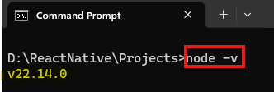
Setting Up React Native Development Environment
9. Install Node.js
Download and install Node JS at the link https://nodejs.org/en
Download the LTS version
If you already have it, no need to replace
Check it’s version by running the command node –v at the command prompt

Slide 41
Setting Up React Native Development Environment
10. Install yarn
Yarn is a package manager — just like npm (Node Package Manager)
Yarn plays an important role in React Native development as a package manager
It helps manage dependencies (libraries, tools, etc.) for your project efficiently
Installs, updates, and removes project dependencies (e.g., react-navigation, axios, etc.)
Uses the package.json file to know what to install
Yarn caches previously installed packages, which speeds up future installs
It installs packages in parallel, making the process faster than npm

Slide 42
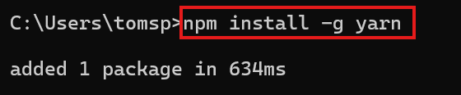

Setting Up React Native Development Environment
Install yarn
To install ‘yarn’, run the below command at the command prompt or PowerShell:
npm install -g yarn
This installs Yarn globally
To verify that Yarn is installed, open a Command Prompt or PowerShell window and run:
yarn –version
If you see the version number, Yarn is installed and ready to use

Slide 43
Setting Up React Native Development Environment
yarn android
yarn android is a command used in React Native projects to build and run your app directly on an Android device or emulator
yarn is a package manager (like npm), and it knows the project scripts from the package.json
When you type yarn android, it runs the Android-specific build process and launches the app automatically
yarn android

